Slide 1
Anticipating threats in natural Systems
UNCLASSIFIED
Task Title: Integrated Risk-Based Environmental Modeling of Extreme Coastal Weather Events
Environmental Systems Modeling Team:
Dr. Todd Steissberg (ERDC-EL)
Mr. John Kucharski (ERDC-EL)
Dr. Jennifer Olszewski (ERDC-EL)
Ms. Marriah Abellera (USACE-IWR)
Dr. Matt Smith (USACE-IWR)
Dr. Billy Johnson (LimnoTech, Inc.)
Ms. Lauren Melendez (ERDC-EL)
External Collaborators:
Scott Steinschneider (Cornell)
Sudarshana Mukhopadhyay (Cornell)
Peter Ruggiero (Oregon State University)
Jon Herman (UC Davis)
ACTIONS IPR Meeting, September 21, 2023

Slide 2
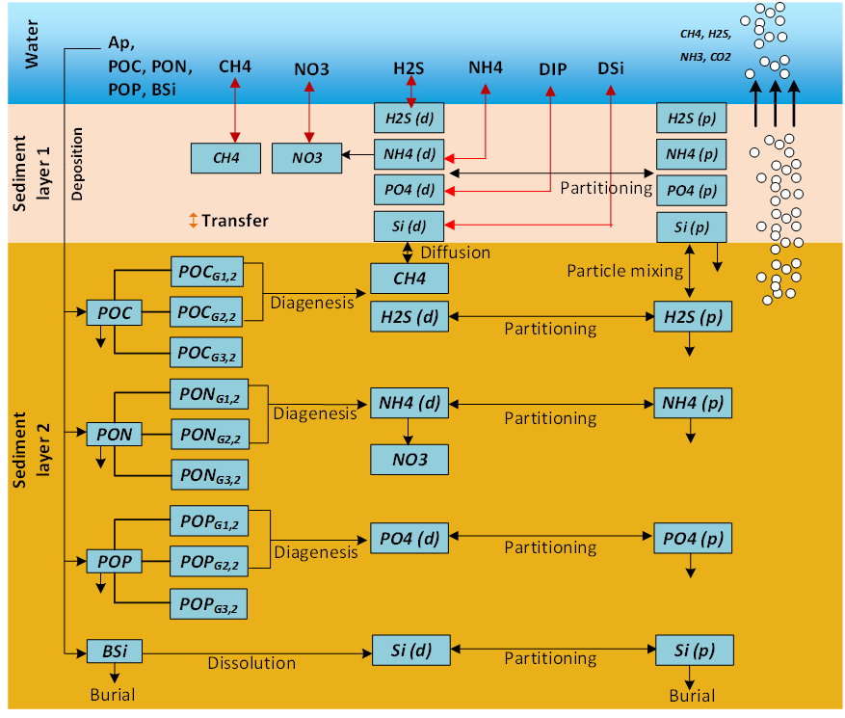
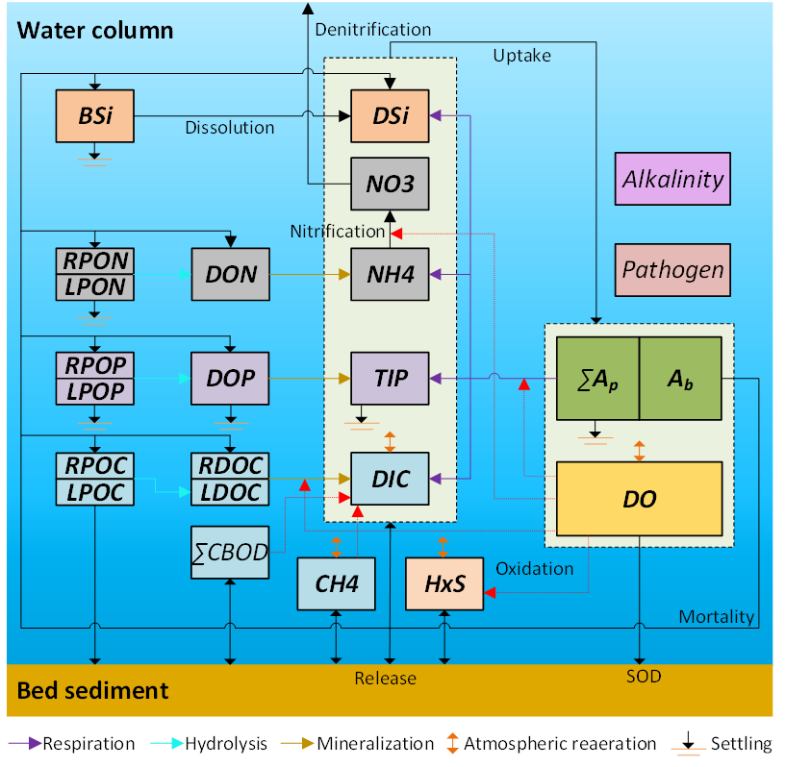
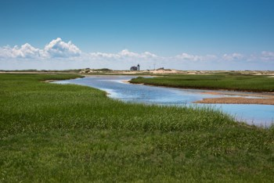
Objective: Integrated Hydro-Ecological Modeling
Develop integrated hydro-ecological models that simulate the complex and dynamics interactions between hydrology, meteorology, climate, water quality (salinity, temperature, nutrients), soil chemistry, vegetation, and morphology processes.
Models will enable evaluating system vulnerabilities and identifying adaptation pathways to improve the resilience of coastal ecosystems to environmental stresses, such as increasing frequency and intensity of coastal storm surges and extreme precipitation events, rising sea levels, decreasing freshwater flows, and increased salinity intrusion.

Slide 3
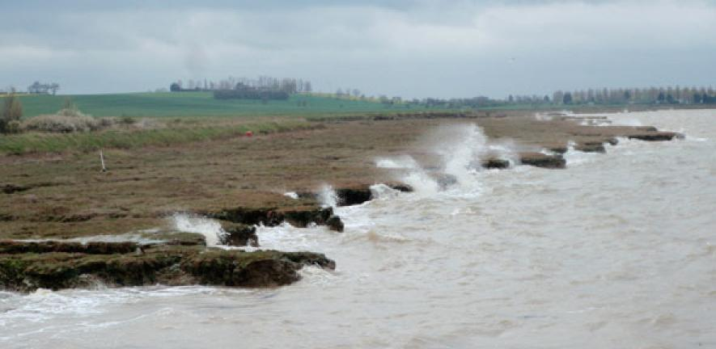
Objective: Integrated Hydro-Ecological Modeling
Models will incorporate process descriptions from the other ACTIONS teams to provide the ability to simulate future conditions and provide more rigorous design tools for construction of Nature Based Features (NBF).
Provides tools for Engineering with Nature (EWN) projects that accurately simulate future conditions with and without projects at the temporal and spatial scales necessary for engineering design

Slide 4
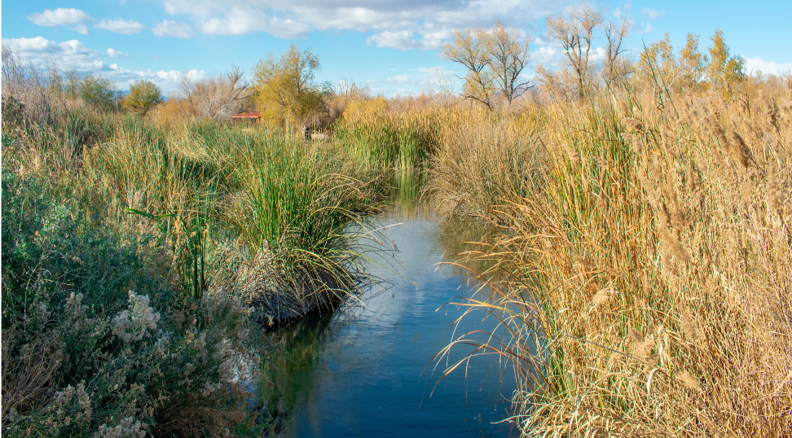
Environmental Modeling Tasks
Environmental Forcing Models
Simulate combinations of environmental forcing conditions to generate a plausible range of coastal hazards while preserving the complex interaction between contributing processes
Water Quality Models
Ecological Models
Relate indicator species responses - e.g., growth and health to water balance components, soil conditions, surface and subsurface water quality - to environmental forcing
Simulate watershed and riverine water quality and contaminant release from soils under saline conditions

Slide 5
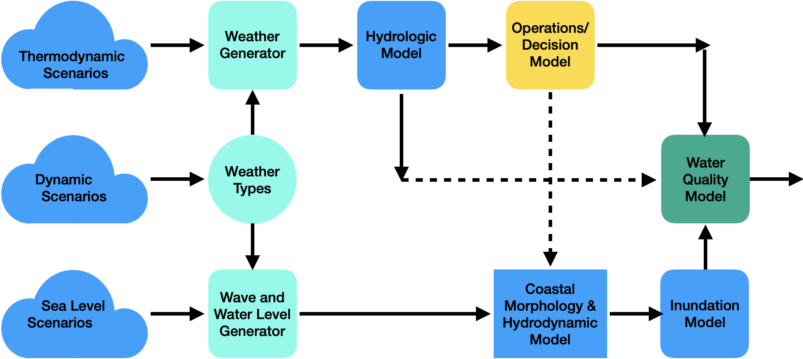
System Modeling Framework
Hydro-Ecological Salt Marsh Model

Slide 6
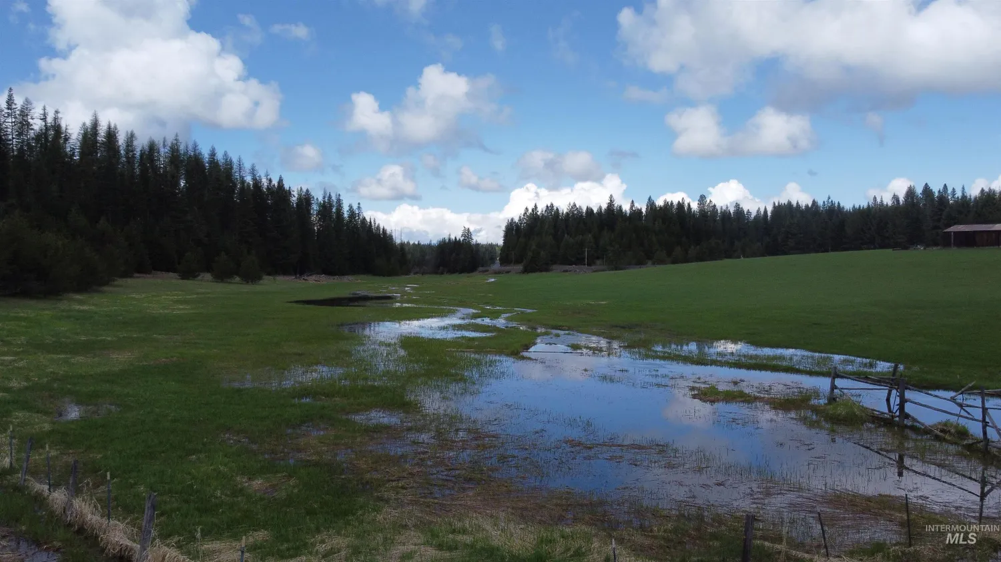
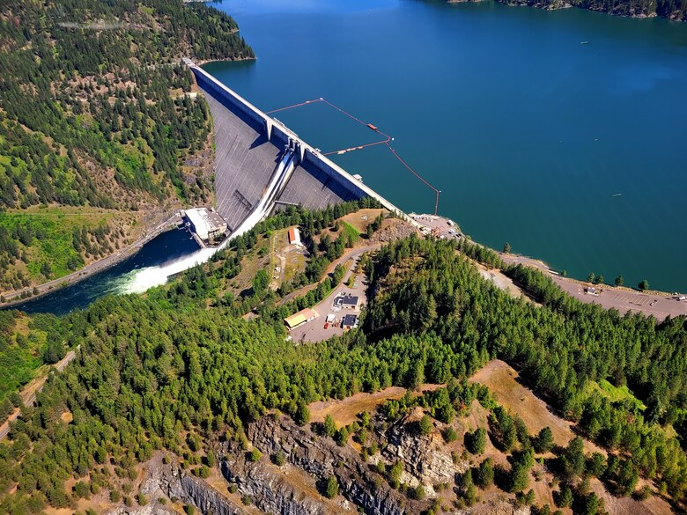
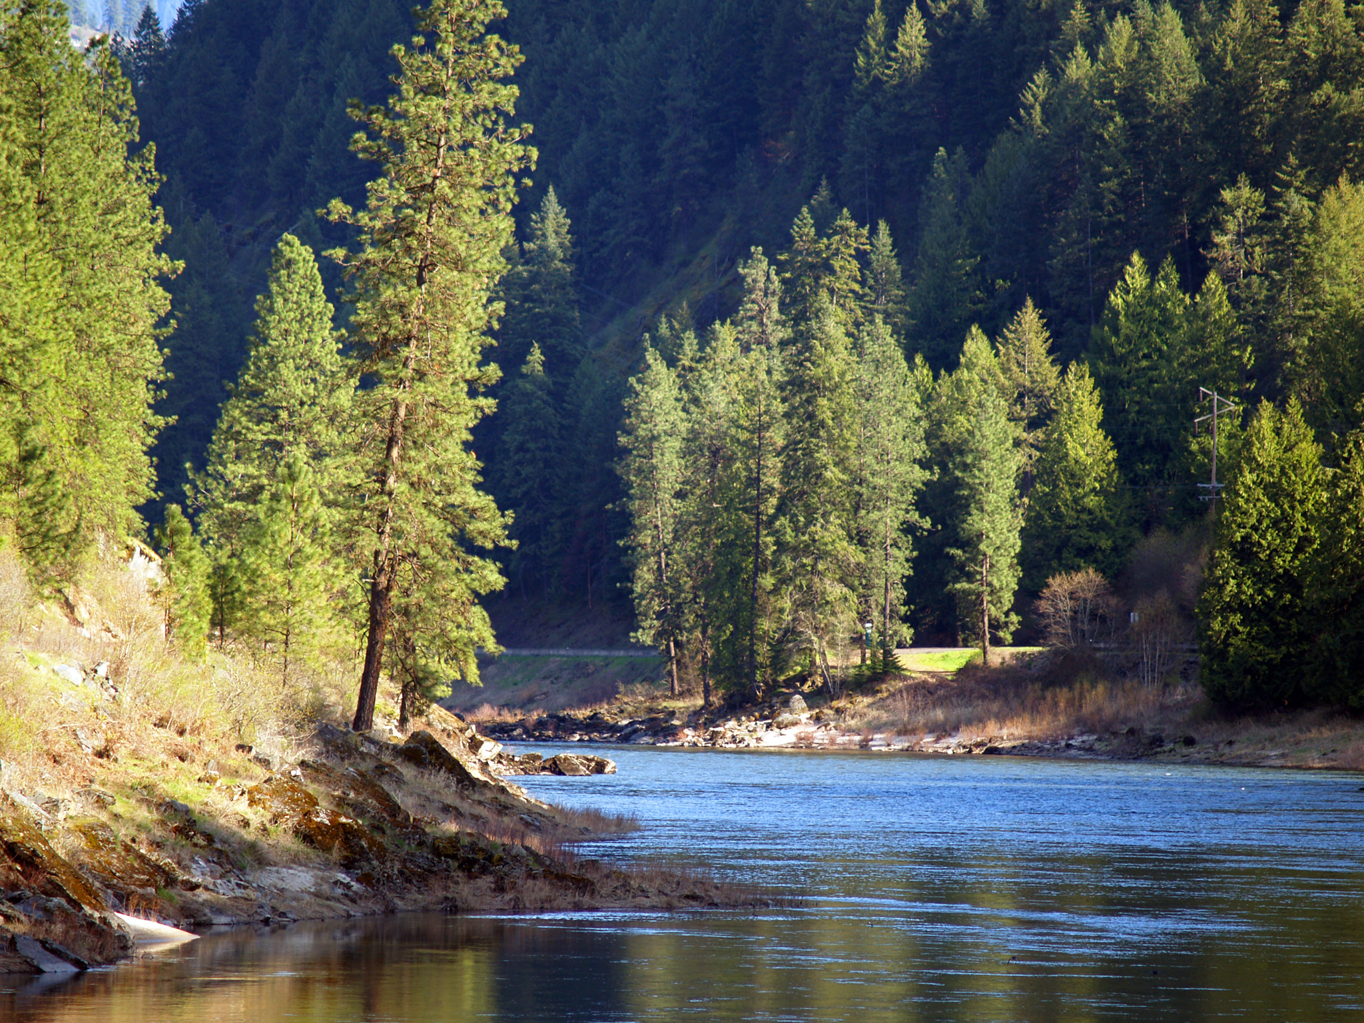
Environmental Modeling Capabilities
Clearwater River Watershed
Linking water quality (WQ) capabilities with existing hydrologic or hydraulic (H&H) models streamlines workflows and reduces costs. The U.S. Army Corps of Engineers (USACE), USDA, and other organizations have several widely deployed models that simulate watershed runoff, river hydraulics, and reservoir operations.
Our team at USACE-ERDC has ClearWater (Corps Library for Environmental Analysis and Restoration of Watersheds). ClearWater provides environmental simulation capabilities that are designed to leverage existing hydrologic and hydraulic (H&H) models.
The ClearWater modules simulate constituent kinetics, heat budget processes, and growth cycles. Capabilities include:
Eutrophication: Nutrients, dissolved oxygen, algae, carbon
Water Temperature
General Constituents
Contaminants
Mercury
Solids
The ClearWater engine computes the transport (advection and diffusion) of heat and mass across the watershed
ClearWater supports a wide range of data visualization and reporting capabilities
ClearWater provides a framework to integrate multiple models.
Runoff
Reservoirs
Rivers
Notes:
Water quality modeling capabilities have advanced significantly, particularly in streamlining workflows and reducing costs by linking water quality (WQ) capabilities with existing hydrologic or hydraulic (H&H) models. The U.S. Army Corps of Engineers (USACE) has been at the forefront of developing widely deployed models that simulate watershed runoff, river hydraulics, and reservoir operations. To further enhance these capabilities, the USACE-ERDC (Engineer Research and Development Center) team has developed a modular library of environmental modeling capabilities, including the standalone river WQ model called ClearWater-Riverine.
ClearWater (Corps Library for Environmental Analysis and Restoration of Watersheds) is specifically designed to integrate environmental simulation capabilities with existing H&H models. It offers a range of modules that encompass various aspects of water quality dynamics and vegetation simulation. These modules include:
1. Nutrient Simulation Module (NSM-I and NSM-II): These modules simulate the transport and transformation of nutrients within the river-reservoir system. They consider processes such as nutrient loading, uptake by algae, nutrient cycling, and water-column interactions.
2. Temperature Simulation Module (TSM): The TSM focuses on simulating water temperature dynamics, considering factors such as solar radiation, air temperature, and streamflow. It helps assess thermal impacts on water quality and aquatic ecosystems.
3. General Constituent Simulation Module (GSM): The GSM is a versatile module that can simulate a wide range of water quality constituents, such as dissolved oxygen, pH, turbidity, or specific pollutants. It enables the assessment of various water quality parameters relevant to specific modeling objectives.
4. Contaminant Simulation Module (CSM): The CSM focuses on simulating the fate and transport of contaminants, including pollutants or toxic substances. It aids in assessing the potential impacts of contaminants on water quality, ecological health, and human health.
5. Mercury Simulation Module (MSM): The MSM is dedicated to simulating the transport and fate of mercury in river-reservoir systems. It helps evaluate the fate and behavior of this toxic element and its potential impacts on water quality and ecosystems.
6. Solids Simulation Module (SSM): The SSM focuses on simulating sediment transport and suspended solids dynamics. It assists in assessing sediment-related processes, such as erosion, deposition, and the impacts on water quality and aquatic habitats.
7. Riparian Vegetation Simulation Module (RVSM): The RVSM simulates the growth and dynamics of riparian vegetation, which plays a crucial role in water quality and ecosystem processes. It helps evaluate the interactions between vegetation, nutrient dynamics, and water quality.
ClearWater includes a comprehensive water quality engine that computes the transport of heat and mass (including nutrients, contaminants, and other constituents) across the watershed. The model considers advection and diffusion processes, reflecting the movement and dispersion of pollutants or other water quality parameters.
Data visualization and reporting capabilities were developed to enable users to visualize and analyze water quality and environmental model results effectively. The integration of these capabilities into a comprehensive water quality framework ensures seamless interaction between the different modeling components, allowing for the development of comprehensive river-reservoir water quality models.
USACE-ERDC's ClearWater-Riverine model and the associated library of environmental modeling capabilities significantly enhance water quality modeling capabilities. By integrating water quality considerations into existing hydrologic and hydraulic models, these advancements support more comprehensive and efficient analysis of water resources, facilitating informed decision-making and effective management of river-reservoir systems.

Slide 7
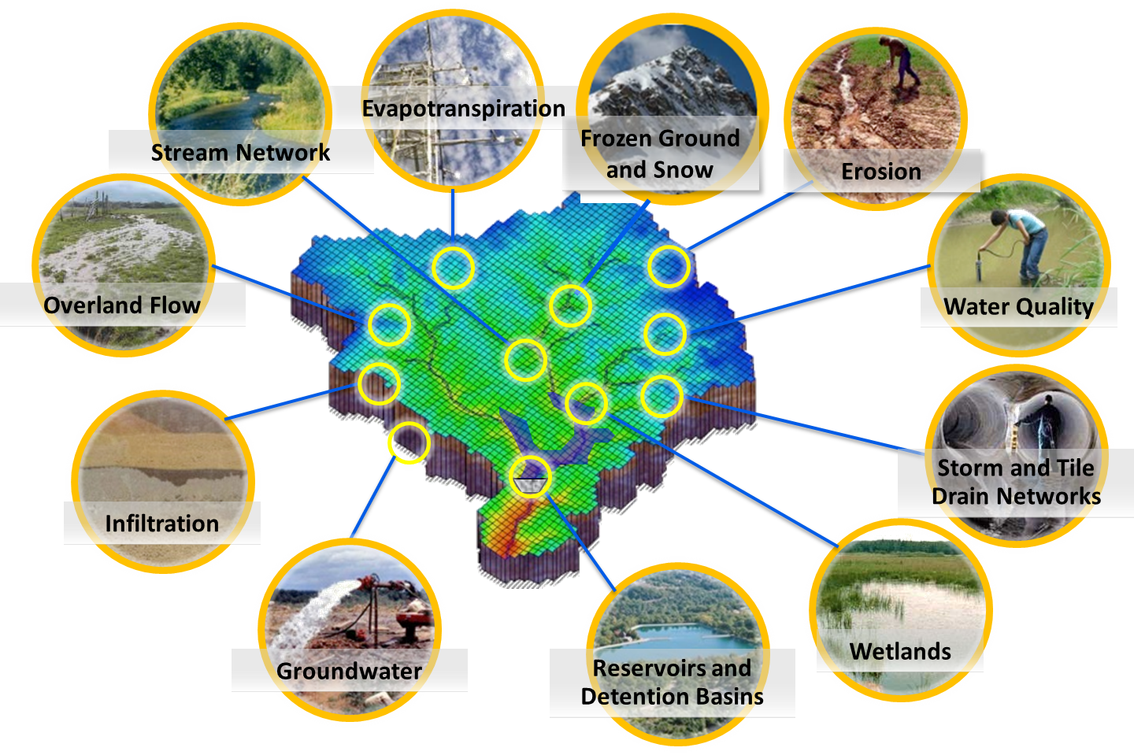
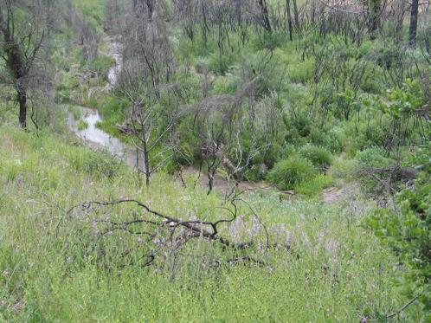
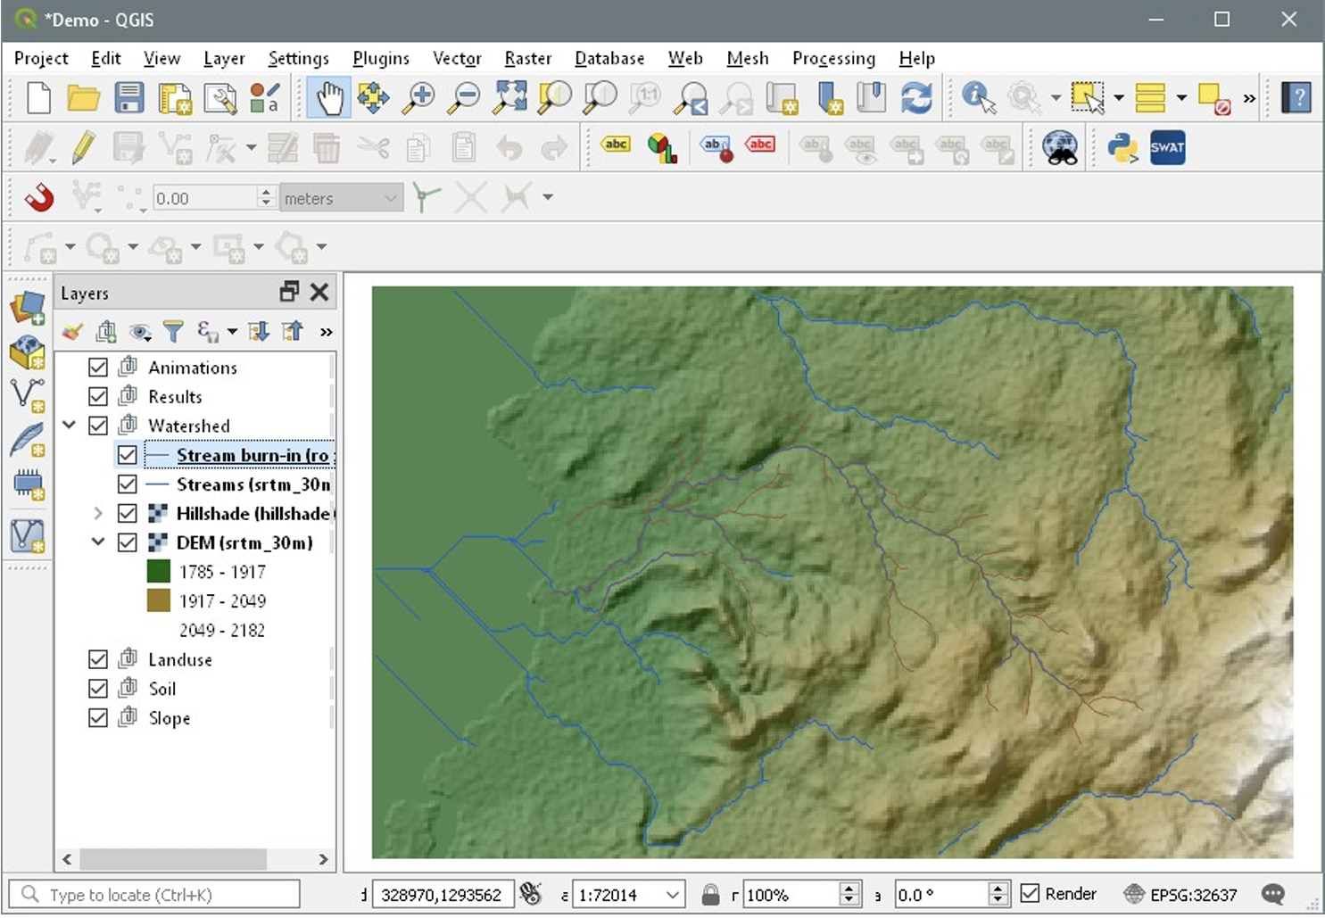
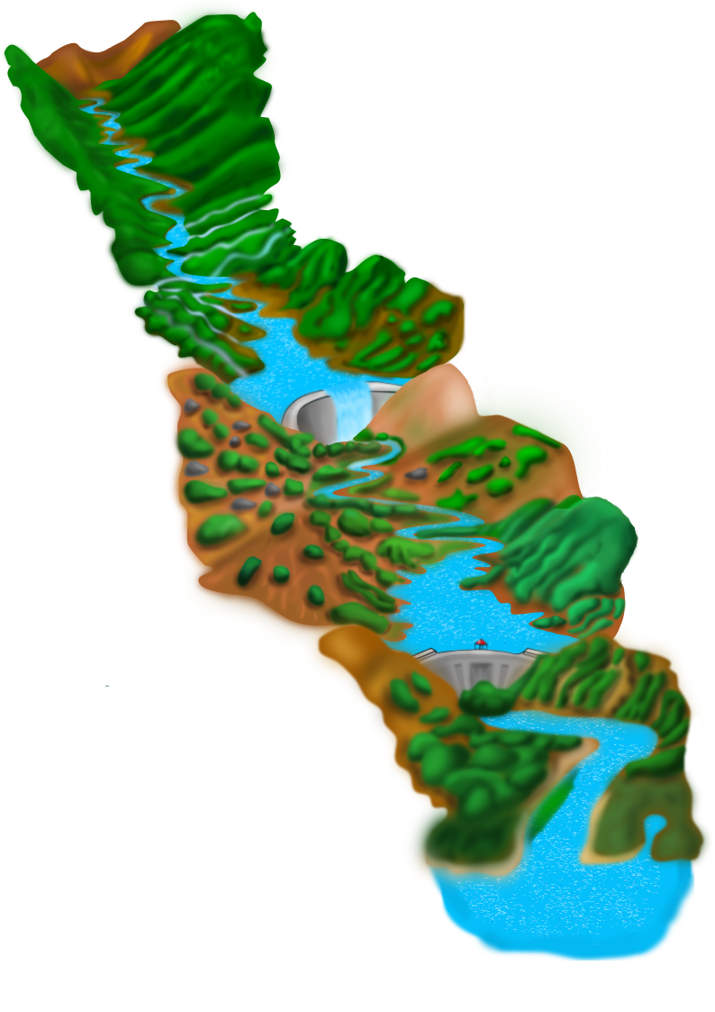
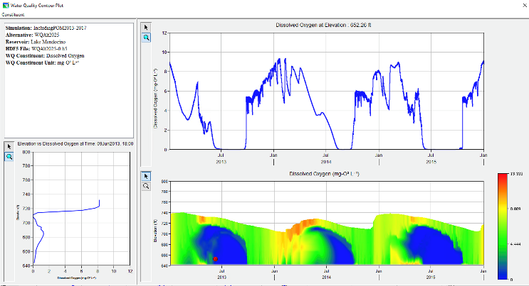
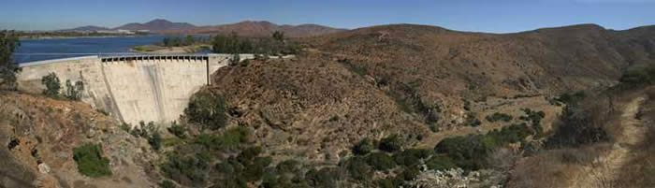
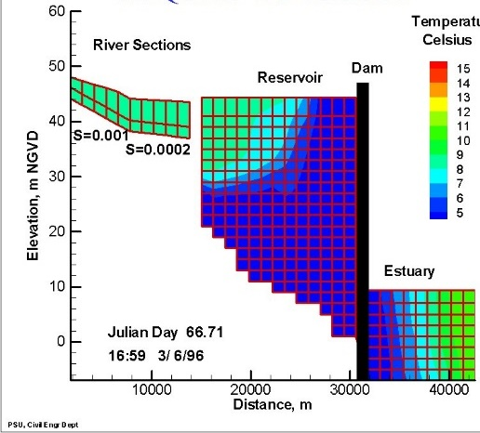
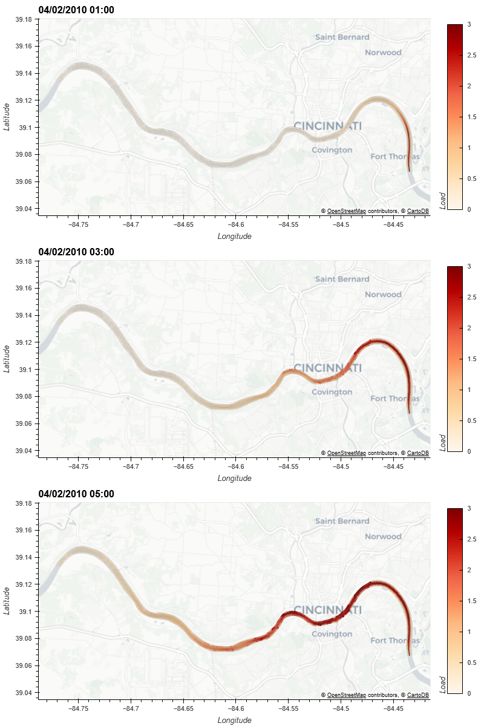
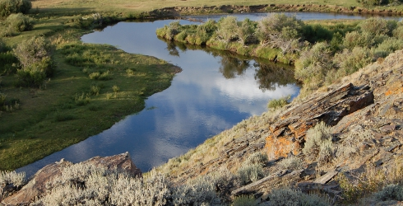
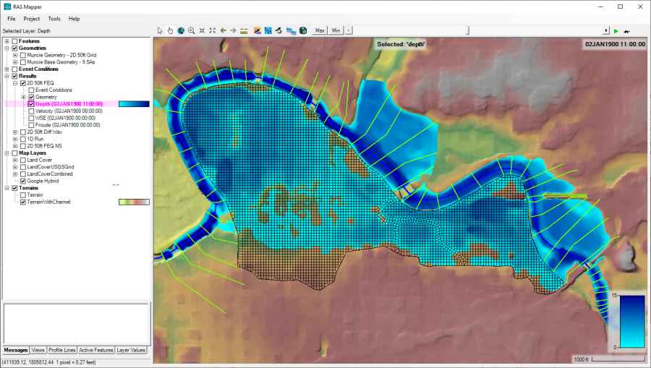
Water Quality and Environmental Systems Modeling
Temperature
Nutrients
Dissolved Oxygen
Algae
Metals
Contaminants
Riparian Vegetation
The Corps Library for Environmental Analysis and Restoration of Watersheds (ClearWater) provides environmental simulation capabilities that leverage existing hydrologic and hydraulic (H&H) models.
Watershed Runoff:
SWAT: Watershed water quantity and quality modeling
GSSHA: Surface and sub-surface water quality modeling and Nature-Based Features design tool
Reservoirs:
CE-QUAL-W2: 2D reservoir-river hydrodynamics and water quality modeling
HEC-ResSim: Reservoir operations and water quality modeling
Rivers and Floodplains:
HEC-RAS: 1D River hydraulics and water quality & vegetation modeling
ClearWater-Riverine: 2D River-floodplain hydraulics and water quality modeling with HEC-RAS and GSSHA
Estuary
Notes:
SWAT (Soil and Water Assessment Tool):
2. GSSHA (Gridded Surface Subsurface Hydrologic Analysis): GSSHA is a widely used hydrologic and hydraulic modeling system developed by the Coastal and Hydraulics Laboratory (CHL), U.S. Army Corps of Engineers (USACE). It integrates surface runoff, infiltration, and subsurface flow processes with hydraulic routing algorithms. GSSHA allows for detailed spatial representation and simulation of hydrological processes in complex terrains, making it valuable for watershed management, flood analysis, erosion prediction, and water resource planning.
3. CE-QUAL-W2 (Corps of Engineers 2D Reservoir Water Quality Model): CE-QUAL-W2 is a two-dimensional water quality and hydrodynamic model developed by the USACE. It simulates the interactions between water quantity and water quality parameters in lakes, reservoirs, and estuaries. CE-QUAL-W2 is employed to evaluate the impacts of nutrient loading, pollutant discharges, and management strategies on water quality, algal blooms, dissolved oxygen dynamics, and ecological processes.
4. HEC-ResSim (Hydrologic Engineering Center - Reservoir System Simulation): HEC-ResSim is a reservoir system simulation software developed by the USACE. It models the operation and management of reservoir systems, considering inflows, outflows, flood control, hydropower generation, and water supply. HEC-ResSim helps optimize reservoir operations, assess water availability, and evaluate the impacts of various management scenarios on water resources and downstream conditions.
5. HEC-RAS (Hydrologic Engineering Center - River Analysis System): HEC-RAS is a widely used software developed by the USACE for modeling river hydraulics and floodplain flows. It simulates one-dimensional (1D) and two-dimensional (2D) flow in river channels, estimating water surface profiles, velocities, and flood extents. HEC-RAS is utilized for floodplain mapping, bridge and culvert design, floodplain management, and hydraulic impact assessments.
6. ClearWater-Riverine: ClearWater-Riverine is a standalone river water quality model developed by the USACE-ERDC (Engineer Research and Development Center). It is part of the ClearWater framework, designed to integrate environmental simulation capabilities with existing hydrologic and hydraulic models. ClearWater-Riverine focuses on simulating the transport and transformation of water quality parameters, nutrients, contaminants, and vegetation dynamics in river systems. It aids in assessing water quality impacts, guiding pollution control strategies, and supporting water resource management decisions.
These modeling tools provide powerful capabilities for analyzing and simulating various aspects of hydrology, water quality, flood analysis, reservoir operations, and river hydraulics. They support water resource planning, flood risk management, ecosystem restoration, and decision-making processes related to water management and infrastructure design.

Slide 8
HEC-RAS-2D: Features and Benefits for Environmental Modeling
HEC-RAS-2D is a powerful hydraulic modeling tool for environmental modeling.
Features:
2D hydraulic modeling captures spatial variability for complex river systems (e.g., braided channels) and provides accurate results
Enables floodplain mapping and analysis for flood risk assessment
Incorporates sediment transport modeling
Supports environmental analysis by providing water flows flows, velocities and depths for a wide variety of complex hydrologic events
Benefits:
Improved accuracy and reliability
Comprehensive analysis and visualization capabilities
Efficient planning and design of hydraulic structures
ClearWater-Riverine model can be linked with 2D HEC-RAS for additional capabilities:
2D water quality modeling
Ecohydrology analyses
2D HEC-RAS, in conjunction with ClearWater-Riverine, offers a comprehensive solution for floodplain management, sediment transport analysis, and habitat assessment.
Notes:
HEC-RAS 2D (Hydrologic Engineering Center - River Analysis System 2D) is module developed by the Hydrologic Engineering Center (HEC), U.S. Army Corps of Engineers (USACE) as an extension to the HEC-RAS hydraulic modeling system. HEC-RAS 2D expands the capabilities of the original 1D modeling approach in HEC-RAS by incorporating two-dimensional (2D) modeling capabilities to simulate flow and water surface profiles in river channels and floodplains.
Unlike the traditional 1D modeling in HEC-RAS, which represents flow characteristics along a river channel, HEC-RAS 2D takes into account the lateral variations in flow and water surface elevation across the entire cross-sectional area of the river and its associated floodplain. It considers the spatial distribution of flow velocities, water depths, and water surface profiles, providing a more detailed representation of complex flow patterns and floodplain inundation.
HEC-RAS 2D employs a finite-volume numerical scheme to solve the shallow water equations, which govern the conservation of mass and momentum in 2D flow. It incorporates various hydraulic features, such as bridges, culverts, levees, and natural topography, allowing for a comprehensive analysis of flow behavior, flood extents, and hydraulic interactions within river systems.
The benefits of using HEC-RAS 2D include:
1. Improved Accuracy: By accounting for lateral variations in flow, HEC-RAS 2D provides a more accurate representation of floodplain inundation and flow dynamics, particularly in areas with complex hydraulic conditions.
2. Detailed Floodplain Analysis: HEC-RAS 2D enables detailed floodplain mapping, identification of flow paths, and evaluation of flood risk and potential impacts on infrastructure and communities.
3. Hydraulic Structure Analysis: The 2D capabilities in HEC-RAS allow for the analysis of flow characteristics around hydraulic structures, such as bridges and culverts, including the assessment of flow velocities, velocities at bridge openings, and floodplain encroachments.
4. Scour and Deposition Analysis: HEC-RAS 2D can assess sediment transport, scour, and deposition patterns, aiding in the evaluation of channel erosion, sedimentation impacts, and riverbed changes.
5. Climate Change Adaptation: The enhanced modeling capabilities of HEC-RAS 2D support the evaluation of the impacts of climate change, sea-level rise, and land use changes on river systems and flood risk.
HEC-RAS 2D is widely used in engineering and water resources management for floodplain mapping, flood risk assessment, bridge and culvert design, floodplain management, river restoration, and flood emergency response planning. It provides valuable insights into flow dynamics, flood extents, and hydraulic interactions within river systems, aiding in informed decision-making for water management and flood risk reduction.

Slide 9
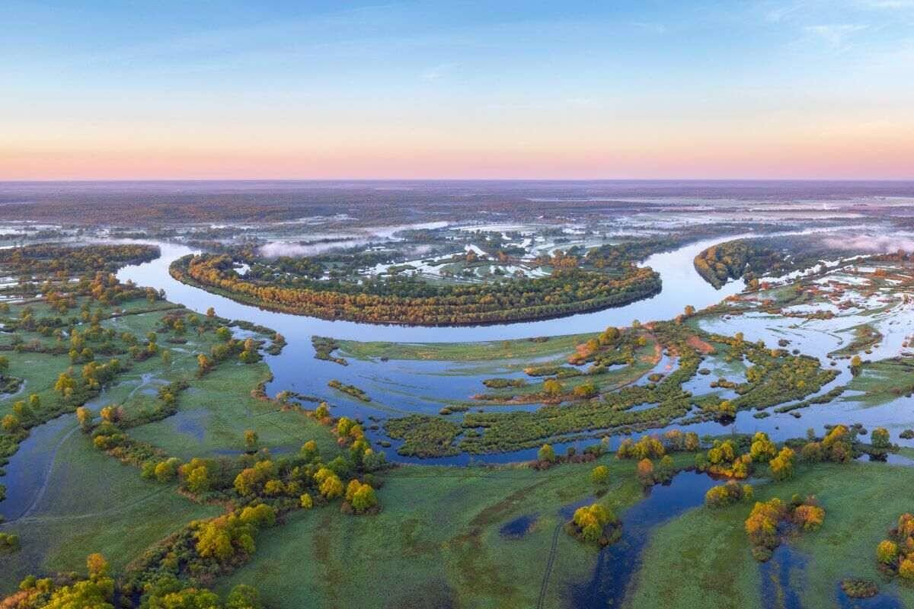
ClearWater-Riverine
The Environmental Laboratory at USACE-ERDC is leading development of a state-of-the-art water quality model, Clearwater-Riverine, that simulates temperature and advanced nutrient cycling in branching river systems and floodplains, incorporating hydrodynamic, water quality, and meteorologic inputs from multiple data sources and models.
ClearWater-Riverine will enable the evaluation of system vulnerabilities and identification of adaptation pathways to improve the resilience of floodplain ecosystems to environmental stresses, which include increasing frequency and intensity of extreme precipitation events and decreasing freshwater flows.
Water quality kinetics, heat budget, and transport simulation capabilities in ClearWater-Riverine are furnished by ERDC's ClearWater modules.
The ClearWater-Riverine framework links the capabilities provided by the ClearWater modules and advection-diffusion engine with the two-dimensional (2D) HEC-RAS model.
HEC-RAS models have been developed for most of the watersheds around the world. By leveraging these existing models, ClearWater-Riverine provides a cost-effective, data-driven tool for impact assessment, planning studies, and the restoration and management of aquatic ecosystems.
Notes:
The ERDC Environmental Laboratory (ERDC-EL) is at the forefront of developing a cutting-edge water quality modeling system called ClearWater-Riverine. This advanced system focuses on simulating temperature dynamics and advanced nutrient cycling in branching river systems and floodplains. It integrates inputs from multiple data sources and models, incorporating hydrodynamic, water quality, and meteorologic information.
The primary goal of ClearWater-Riverine is to assess system vulnerabilities and identify adaptation pathways that enhance the resilience of floodplain ecosystems to environmental stresses. These stresses include the increasing frequency and intensity of extreme precipitation events and decreasing freshwater flows. By accurately simulating water quality kinetics, heat budget, and transport, ClearWater-Riverine enables a comprehensive evaluation of the impacts on water quality and provides insights into potential mitigation and restoration strategies.
The modeling capabilities of ClearWater-Riverine are enhanced through the integration of ERDC's ClearWater modules. These modules provide the necessary functionalities for simulating water quality kinetics, heat budget, and transport processes. They form the foundation for the water quality simulations within the ClearWater-Riverine framework.
Furthermore, ClearWater-Riverine is designed to leverage the widely used two-dimensional (2D) HEC-RAS model. By linking the capabilities of ClearWater modules and the advection-diffusion engine with the 2D HEC-RAS model, ClearWater-Riverine combines the strengths of both systems. This integration allows for a cost-effective and data-driven approach to impact assessment, planning studies, and the restoration and management of aquatic ecosystems.
The availability of HEC-RAS models for numerous watersheds worldwide enhances the applicability and efficiency of ClearWater-Riverine. By utilizing existing HEC-RAS models, ClearWater-Riverine eliminates the need to develop new models from scratch. This approach streamlines the modeling process, reduces costs, and facilitates wider adoption of the system for various water resource management and restoration initiatives.
In summary, the development of ClearWater-Riverine by the ERDC-EL represents a significant advancement in water quality modeling. By simulating temperature dynamics and advanced nutrient cycling, integrating multiple data sources and models, and linking with the 2D HEC-RAS model, ClearWater-Riverine provides a powerful tool for impact assessment, planning, and ecosystem management in river systems and floodplains.

Slide 10
ClearWater-Riverine: Comparison of ClearWater-Riverine (left) with the EFDC model (right)
Notes:
This slide presents animations that showcase the performance of ClearWater-Riverine in modeling the Ohio River, with a comparison to an EFDC (Environmental Fluid Dynamics Code) simulation of the same system. The left panel displays the ClearWater-Riverine model animation, while the right panel showcases the EFDC simulation.
The animations provide a visual representation of the dynamic behavior and water quality processes within the Ohio River. They allow for an assessment of how ClearWater-Riverine and EFDC capture the complex interactions of flow, water quality, and associated phenomena. The animations highlight the movement and distribution of water quality constituents, demonstrating the models' ability to simulate the transport and fate of pollutants or other relevant variables.
The comparison between ClearWater-Riverine and the EFDC model is noteworthy, as both models demonstrate good agreement with observed data. This indicates that ClearWater-Riverine performs on par with the established EFDC model, providing reliable and accurate simulations of water quality dynamics. The alignment between the models and observed data reinforces ClearWater-Riverine’s validity and strengthens confidence in its simulation capabilities.
The successful comparison of ClearWater-Riverine with the EFDC model as well as with observed data further emphasizes its efficacy in representing the complex hydrodynamics and water quality characteristics of the Ohio River. This alignment with observations is crucial for supporting sound decision-making processes, as it confirms ClearWater-Riverine’s ability to capture the essential dynamics and patterns of the river system.

Slide 11
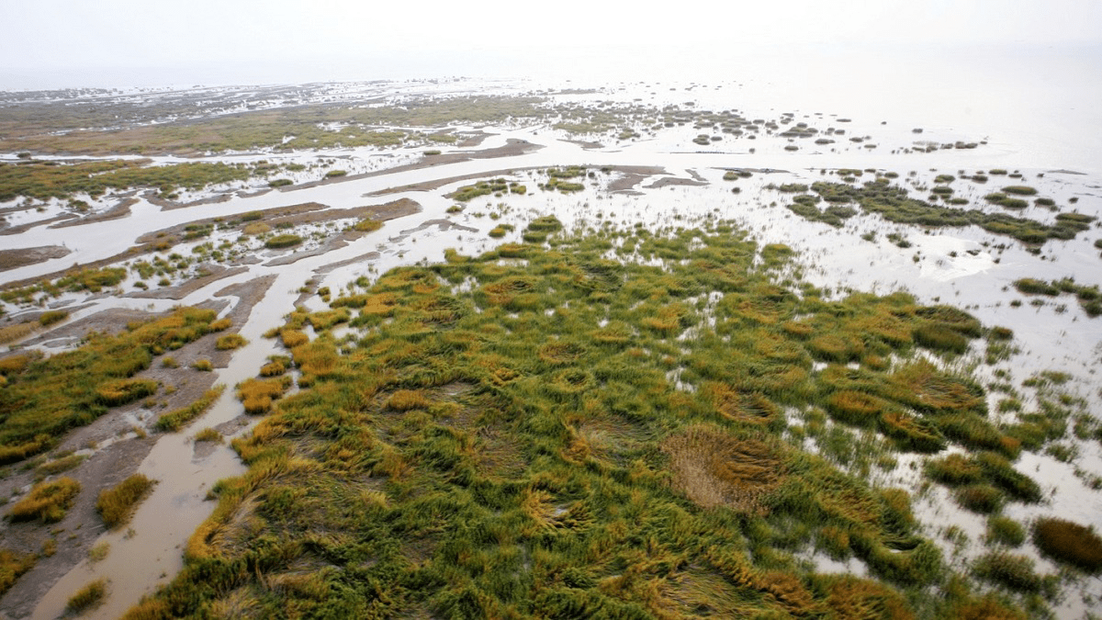
FY23 Accomplishments
Environmental Forcing Model
Generated Paleo-reconstructed water levels and climate scenarios
Produced internally consistent paleo-reconstructed weather, operations, and riverine flows including under climate change for the Sacramento, San Joaquin, and Tulare basins
This work will be leveraged for ACTIONS in FY24 to answer the following questions:
If sea level rise will cause environmental damage by advancing saline water further into the bay
If any the advancement will be offset or exacerbated by increased precipitation intensity and lower snowpacks
Moved away from the COSMOS models this year
We are still using the Delft3D models that started with COSMOS as a basis but have now adopted the SF Bay Community Models, https://www.d3d-baydelta.org

Slide 12
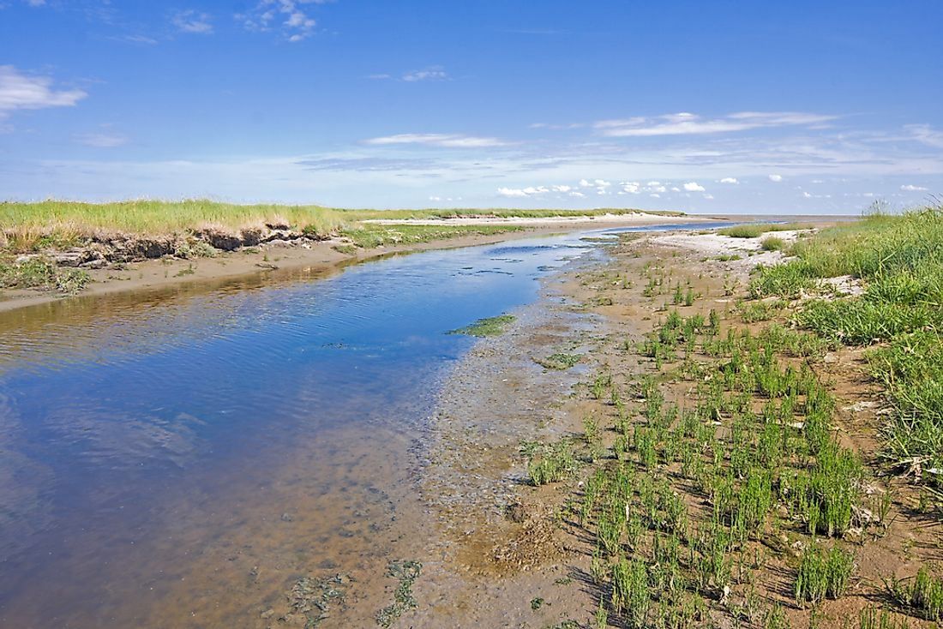
FY23 Accomplishments
Water Quality Model (Task 3, 5, 7)
Linking ClearWater with WEBMOD for improved contaminant modeling:
WEBMOD (USGS’s Water, Energy, and Biogeochemical Model) flows linked with HEC-RAS-2D
Linking WEBMOD single-cell water quality outputs linked with ClearWater
Specifically linking with PHREEQC within WEBMOD:
PHREEQC is an aqueous geochemical model that simulates chemical reactions as waters evaporate, mix, and react within the various reservoirs of the model. The reactions that can be specified for a reservoir include equilibrium reactions among water, minerals, surfaces, exchangers, and kinetic reactions such as kinetic mineral dissolution or precipitation, biologically mediated reactions, and radioactive decay.
WEBMOD also simulates variations in the concentrations of the stable isotopes deuterium and oxygen-18 as a result of varying inputs, mixing, and evaporation.
Data storage and exchange library to link the hydrologic and hydraulic models with the water quality and vegetation models.

Slide 13
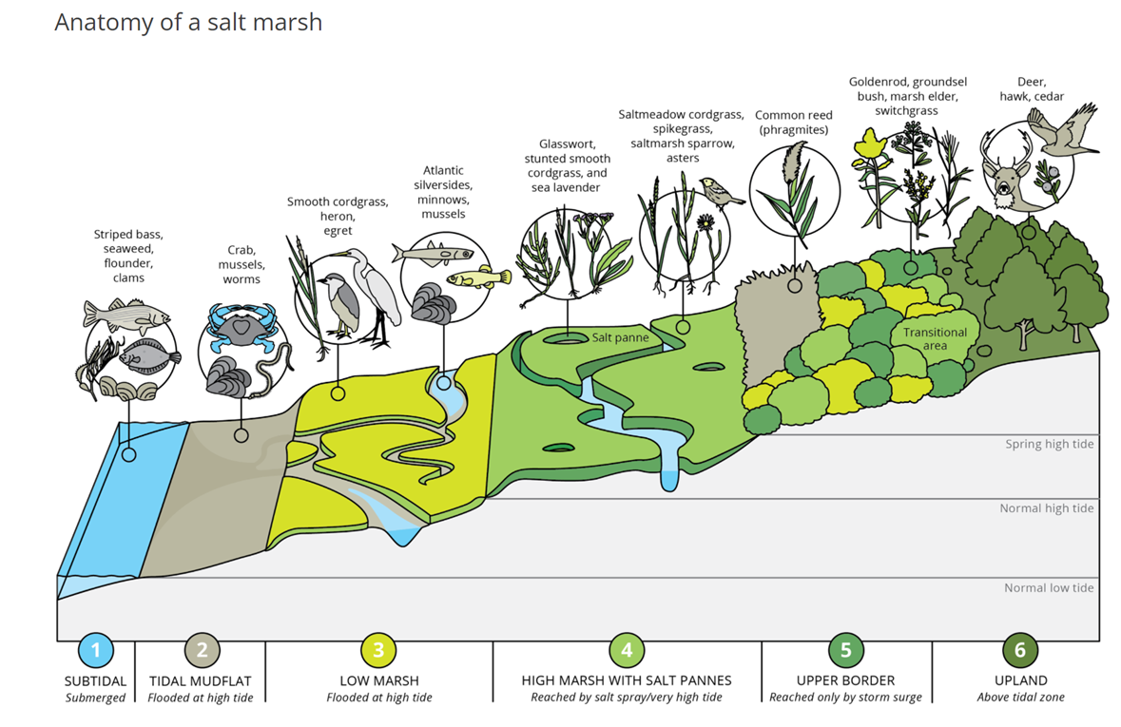
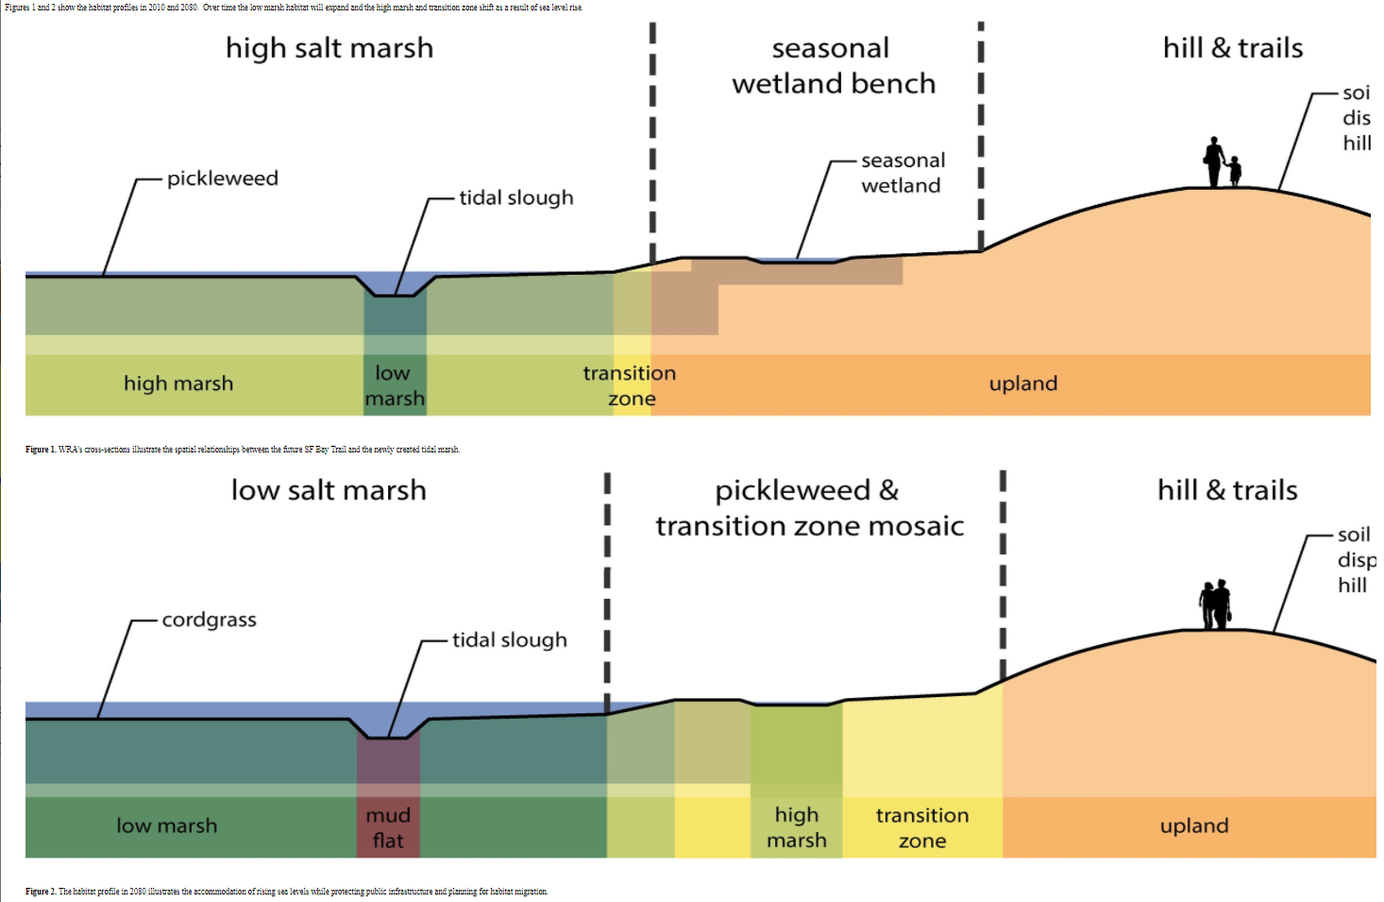
Hydro-Ecological Salt Marsh Model (Task 11)
Objective: Develop a “unit” salt marsh model that can demonstrate how to:
Design salt marshes for specific performance objective(s) that are robust to range of potential future sea level and sediment input conditions
Quantify performance using measurable performance metric(s)
Identify those marsh parameters (e.g., platform depth, vegetation species dominance, etc.) to which performance is most sensitive to.
Lead to the development of generalized salt marsh model design guidelines

Slide 14
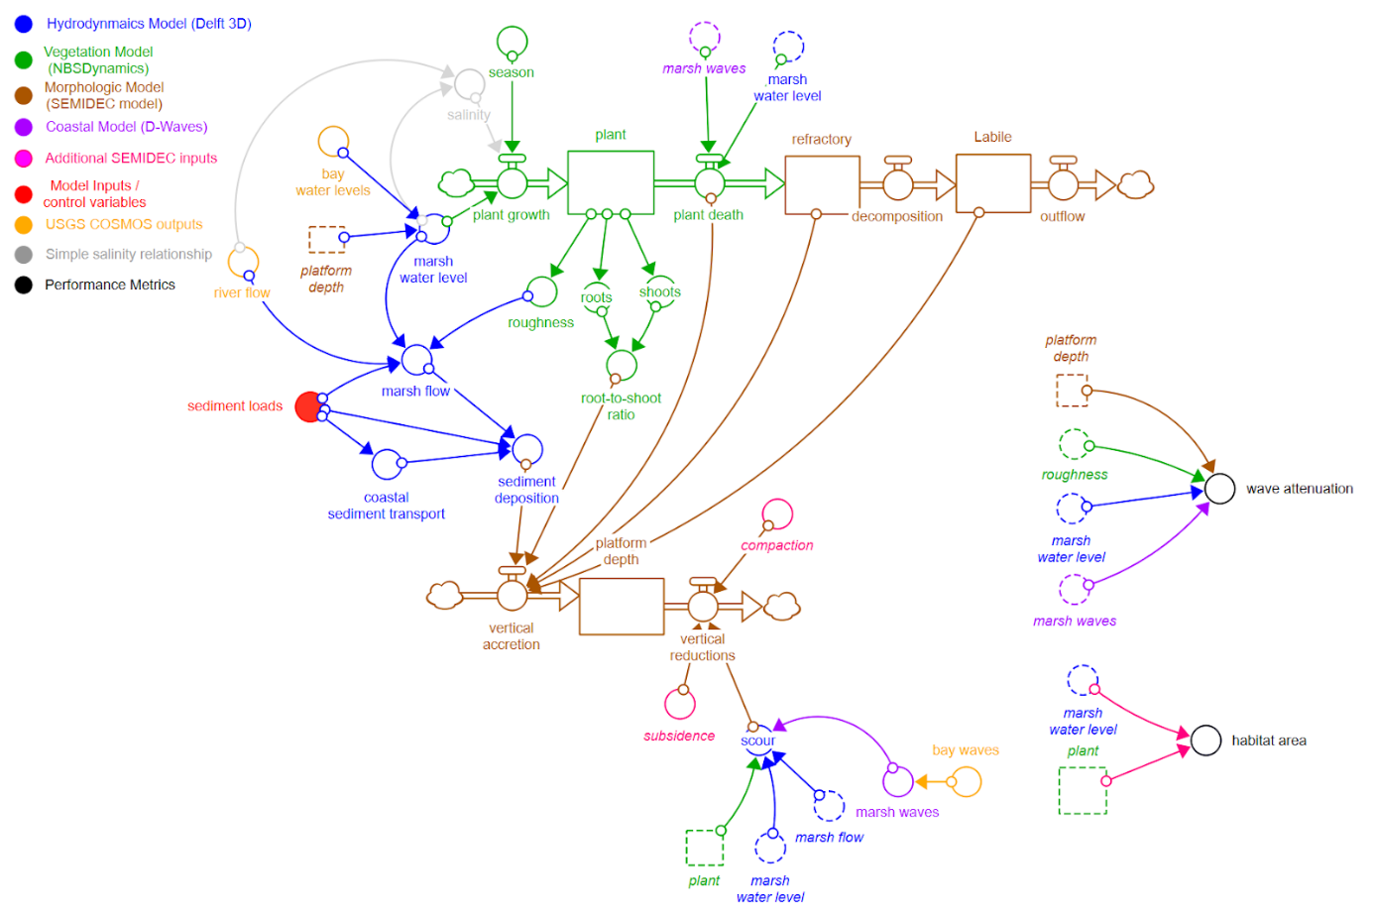
FY23 Salt Marsh Model: Design
Flow diagram of our complete salt marsh model
Performance metrics we will compute

Slide 15
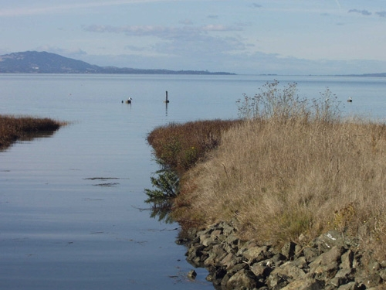
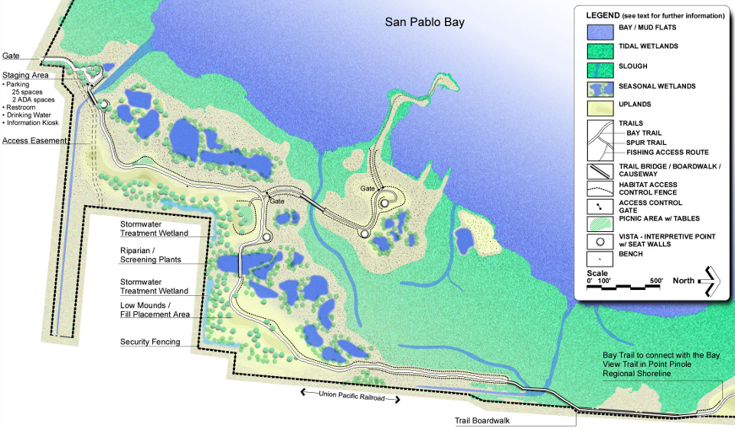
FY23 Salt Marsh Model Case Study
Case Study Site: Dotson Family Marsh, San Pablo Bay
The Dotson Family Marsh is a 238-acre (96 ha) regional park on San Pablo Bay in the East San Francisco Bay Area city of Richmond, California.
In 2009 the East Bay Regional Parks District acquired the marsh site, adding it to Point Pinole Regional Shoreline.
A habitat restoration plan for 60 acres of wetlands and 90 acres of California coastal prairie was subsequently approved.

Slide 16
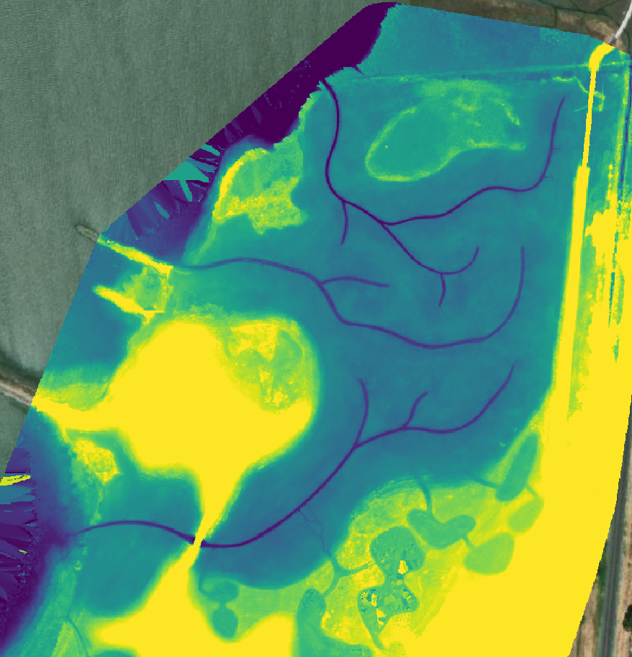
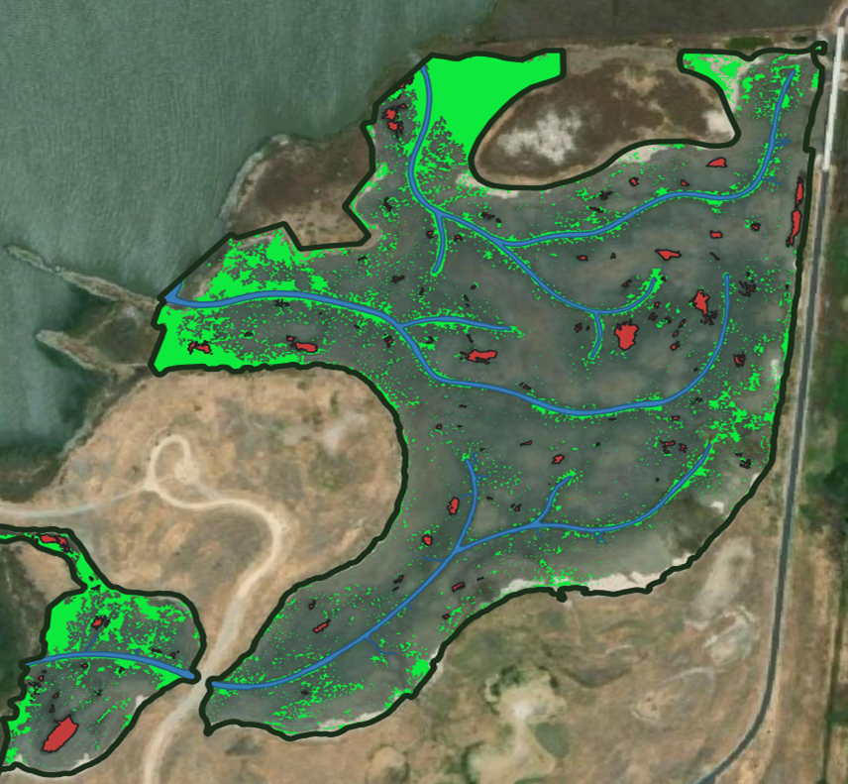
FY23 Salt Marsh Model Case Study
Vegetation coverage, Dotson Family Marsh
The colors represent different species.
The site started out with no vegetation. This snapshot is a few years after installation.
Elevations, Dotson Family Marsh

Slide 17
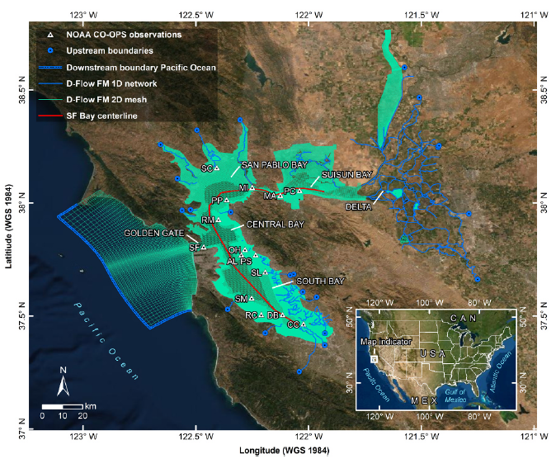
FY23 Salt Marsh Model Case Study
Map showing the larger model (Nederhoff et al. 2021) that we nested our salt marsh model into.
This larger model will be used to generate water level and wave boundary conditions for our smaller salt marsh model.

Slide 18
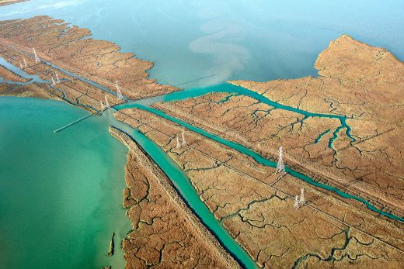
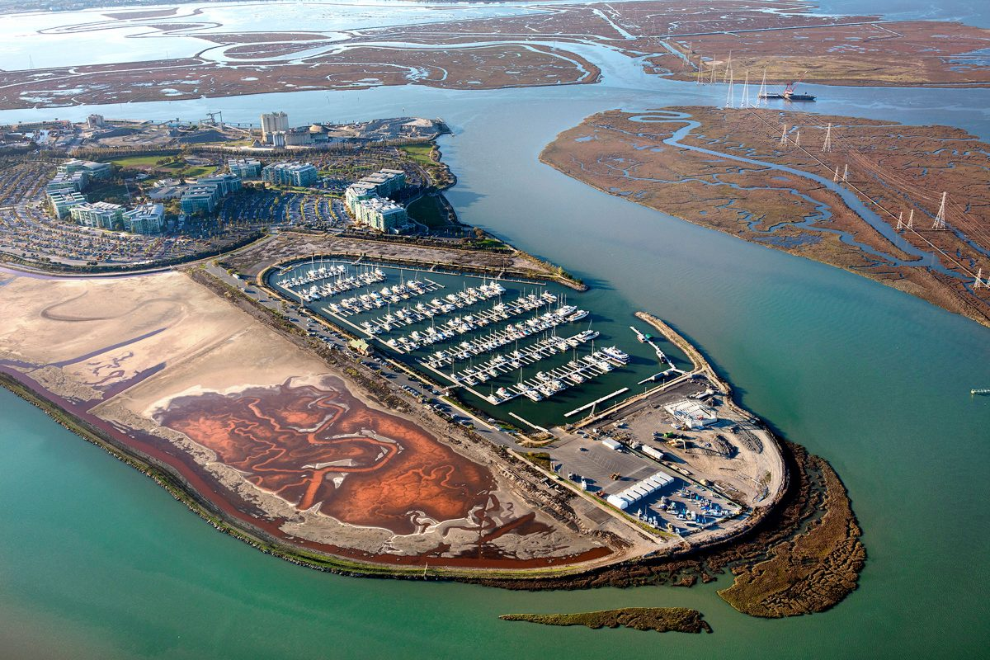
FY23 Hydro-Ecological Model Development
Initiated long-term collaboration with Deltares to explore the modeling of salt marshes with the goal of informing design for specific performance objectives.
Designed the dynamic salt marsh model. The model will dynamically couple hydrodynamics (Delft3D), waves (Waves-D), vegetation (NBSDynamics), and morphology (SEMIDEC) models. This work was performed in collaboration with IWR (Dr. Matt Smith) and Deltares.
Working meeting with Deltares (in Delft) Oct 24-27: Finalizing and linking the components of the salt marsh model (hydrodynamics + waves + sediment, morphology, and vegetation growth / death)
Weekly meetings with Deltares Delft 3D experts to continue to make progress on the model

Slide 19
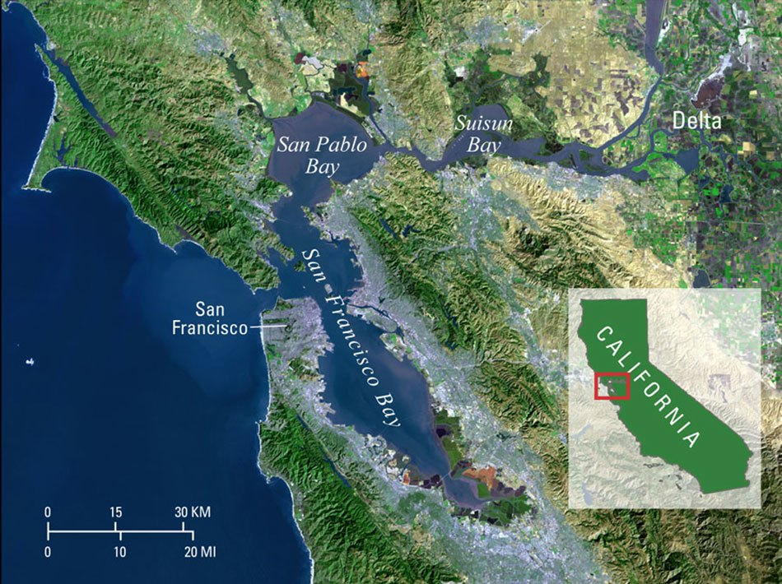
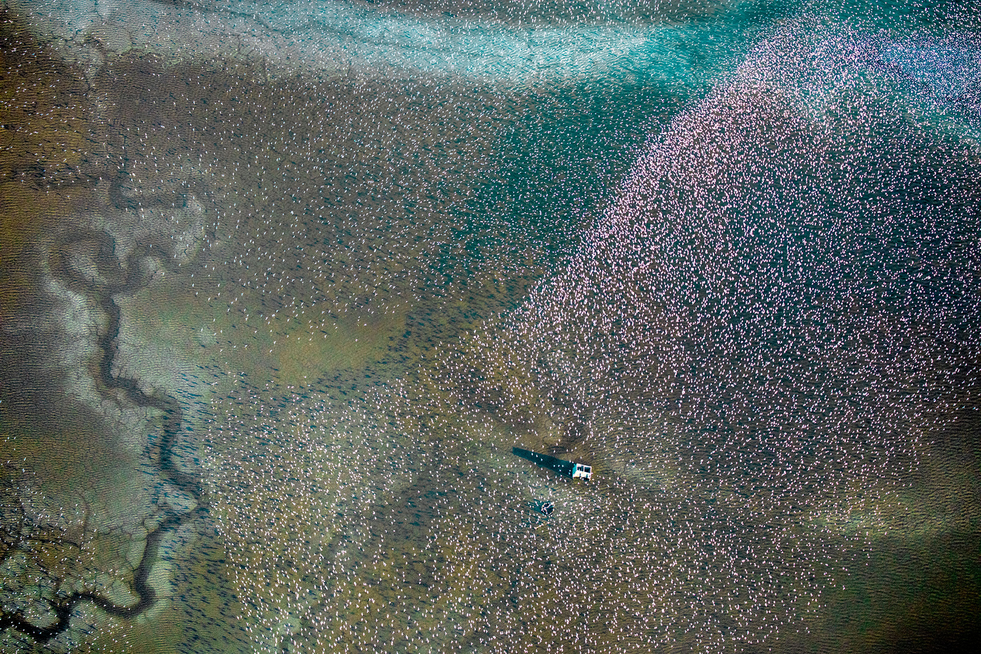
FY23 Hydro-Ecological Model Development
Matt spent 2 weeks and John spent 1 month at Deltares in July to learn about the vegetation life cycle model NBSDynamics and to develop our salt marsh model, which will dynamically couple hydrodynamics (Delft3D), waves (Waves-D), vegetation (NBSDynamics), and morphology (SEMIDEC) models.
Case study under development for an ecosystem restoration site in San Francisco Bay.
John led an EGU session on nature-based features (including salt marshes) and their design
Matt submitted an abstract for our team to present on this salt marsh model at DMDU conference in October in Delft.

Slide 20
FY23 Products: Hydro-Ecological Salt Marsh Model
Developed an open-source python package that couples hydro-morpho-dynamic and vegetation models to compute sedimentation, erosion, and diagenesis of organic matter on salt marshes.
Dynamical version of the SEMIDEC model (Morris and Bowden, 1986)
Model agnostic
Drives Marsh Equilibrium Model (MEM) outputs
This package is being coupled with Delft3D and NBSDynamics

Slide 21
FY23 Products: Journal Publications
Steinschneider, S., Herman, J. D., Kucharski, J., Abellera, M., & Ruggiero, P. (2023). Uncertainty decomposition to understand the influence of water systems model error in climate vulnerability assessments. Water Resources Research, 59, e2022WR032349. https://doi.org/10.1029/2022WR032349
To accurately characterize coastal flood hazards, we must consider both natural water level variability and climate change-induced sea-level rise.
We developed a paleo-proxy-based reconstruction of coastal flood events over the last 500 yr to capture natural water level variability and superimpose that reconstruction onto expected sea-level rise to explore interannual and multidecadal variability in plausible future coastal flood risk.

Slide 22
FY23 Products: Journal Publications
Mukhopadhyay, S., Leung, M., Cagigal, L., Kucharski, J., Ruggiero, P., & Steinschneider, S. (2023). Understanding the natural variability of still water levels in the San Francisco Bay over the past 500 yr: Implications for future coastal flood risk. Journal of Geophysical Research: Oceans, 128, e2022JC019012. https://doi.org/10.1029/2022JC019012
Climate vulnerability assessments rely on water infrastructure system models that imperfectly predict performance metrics under ensembles of future scenarios.
Reduced complexity system representations are needed to support these assessments, especially when large ensembles are used to better characterize future uncertainties.
An important question is whether the total uncertainty in the output metrics is primarily attributable to the climate ensemble or to the systems model itself.
We developed a method to address this question by combining time series error models of performance metrics with time-varying Sobol sensitivity analysis. The method is applied to a reduced complexity water resource systems model to demonstrate the decomposition of flood risk and water supply uncertainties under an ensemble of climate change scenarios.

Slide 23
FY23 Products: Conference Presentations
European Geophysical Union Conference, April 2023
Todd E. Steissberg, Billy E. Johnson, and Zhonglong Zhang, 2023. Eco-Hydrology Engineering Design Tool - ClearWater Capabilities - General Constituents, Nutrients, and Contaminants. European Geophysical Union General Assembly 2023. Vienna, Austria
John Kucharski, Scott Steinschneider, Jennifer Olszewski, Jonathan Herman, Saiful Rahat, Patrick Ray, Wyatt Arnold, and Romain Maendly, 2023. Linking Exploratory Scenarios to Process-Informed Insights in Climate Vulnerability Assessments. European Geophysical Union General Assembly 2023. Vienna, Austria
Jennifer Olszewski, John Kucharski, Matthew Smith, Marriah Abellera, and Todd Steissberg, 2023. Nature-Based Features: Developing a Framework to Shift Them from Risky Investments to Reliable and Robust Solutions. European Geophysical Union General Assembly 2023. Vienna, Austria
Estifanos Addisu Yimer, Billy Johnson, Jiri Nossent, Todd E. Steissberg, Hans Van de Vyver, and Ann van Griensven, 2023. Session: Nature-Based Solutions to Protect Against Hydro-Meteorological Extremes. European Geophysical Union General Assembly 2023. Vienna, Austria.
Decision Making Under Deep Uncertainty (DMDU) Conference, Delft, The Netherlands, Nov 2023
Matthew Smith, Jennifer Olszewski, John Kucharski, Marriah Abellera, and Todd Steissberg, 2023 (submitted). Evaluating hydrodynamic and biophysical feedbacks leading to steady state conditions in a coastal salt marsh of San Francisco Bay, CA. 10th Annual Conference of the Society for Decision Making Under Deep Uncertainty (DMDU), Delft, the Netherlands.

Slide 24
Projected FY24 Tasks and Products
Tasks
Complete linking the hydrodynamics + veg + sediment models
Calibrate/validate the dynamic salt marsh model for the Dotson Family marsh location.
Investigate different design scenarios (e.g., different starting bottom elevations, different marsh widths, different sediment loadings, etc.)
Develop emulator to simulate waves and water levels and combine it our climate scenarios to understand how compound hazards may be changing under climate change.
Link with water quality
Products:
Final version of dynamic salt marsh model, Oct 31, 2023.
Technical note summarizing salt marsh model development and case study, Nov 30, 2023.
Peer-reviewed paper on the salt marsh model: “Modeling evolution and dynamic equilibrium of constructed salt marshes using a coupled morpho-dynamic and vegetation model to evaluate wave attenuation performance”, Sep 30, 2024
Future work (Post-ACTIONS, ESTCP Proposal):
Explore how sensitive performance metrics like wave attenuation are to different design parameters like starting bottom elevation and berm presence/absence.

Slide 25
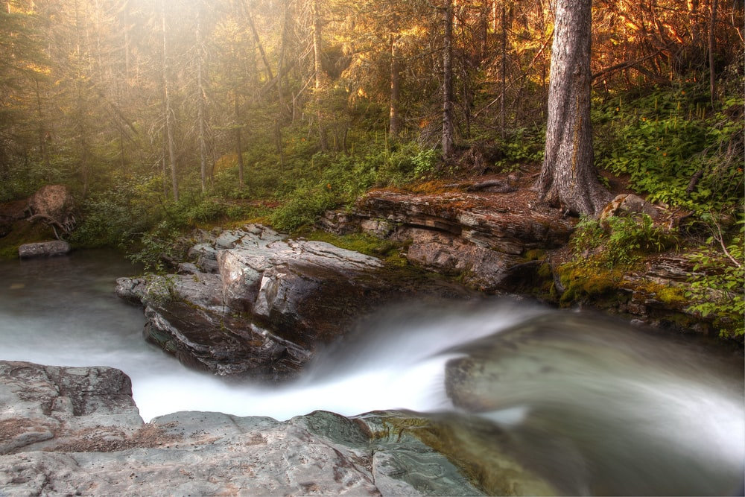
Questions?

Slide 26
ClearWater-Riverine: E. Coli Transport in the Ohio River
Notes:
ClearWater-Riverine proved to be a valuable tool for simulating E. Coli transport in the Ohio River, demonstrating its effectiveness in addressing water quality concerns. The case study involved utilizing an existing 2D HEC-RAS hydraulics model and incorporating observed data to enhance the accuracy of the simulation. To facilitate the analysis and visualization of the results, a Jupyter notebook was developed specifically for this case study.
The Jupyter notebook provided a user-friendly interface for exploring and presenting the model outputs. It included informative plots that showcased the model results, including the distribution of E. Coli over time and its spatial patterns within the river system. The visualization of the model geometry offered a clear understanding of the study area and how the simulation was performed.
The animation displayed in the slide further illustrated the capabilities of ClearWater-Riverine. It showed the dynamic distribution of E. Coli, both laterally and longitudinally, as it moved through the river system over time. This visualization allowed for a comprehensive understanding of how the bacteria dispersed within the river, providing insights into potential contamination hotspots and areas of concern.
By incorporating ClearWater-Riverine into the analysis of E. Coli transport, the case study demonstrated the system's ability to address specific water quality issues and inform decision-making processes. The combination of the 2D HEC-RAS hydraulics model, observed data, and ClearWater-Riverine's water quality modeling capabilities provided a comprehensive and accurate assessment of E. Coli transport dynamics in the Ohio River.
Overall, the case study showcased the successful application of ClearWater-Riverine in simulating and analyzing E. Coli transport. The integration of various modeling components and the development of the Jupyter notebook allowed for efficient data analysis, visualization, and interpretation of the model results. ClearWater-Riverine's ability to accurately simulate water quality dynamics, as demonstrated by the E. Coli transport case study, positions it as a valuable tool for addressing water quality challenges and supporting informed decision-making in river systems.

